Slide 1

Tutorial on IQM Tools Pro
Basic Pharmacometrics
Integrated Solutions for Quantitative Drug Development
From Mechanistic Models to Complex Trial Simulation
Henning Schmidt, IntiQuan GmbH
3

Slide 2
Tutorial Outline
General introduction to the IQM Tools Suite
Compliance mode
Models: dosing, output and parameter definitions
  Define dosing inputs
  Define observation outputs
  Define parameters to estimate and to use as regression parameters
Dosing description and simulation
  Definition of dosing schemes
  Simulation of dosing schemes

Slide 3
Tutorial Outline
Interface to NLME Tools
  Conversion of IQMmodels to NONMEM and MONOLIX
  Running NONMEM and MONOLIX from IQM Tools
  Fitanalysis results – overview
  Robustness analysis
Nonlinear mixed effect modeling tools
  VPC
  Bootstrap
  Stepwise covariate search
  Model comparison
Simulations

Slide 4
Tutorial Info
In large parts you will have the opportunity to get hands-on-experience
>> installIQMtoolsInitial
Commands shown in these boxes should be entered on the MATLAB
command line, during the tutorial
********** MODEL NAME
Simple model
********** MODEL STATES
d/dt(Ad)= -ka*Ad + INPUT1
d/dt(Ac)= ka*Ad – CL/Vc*Ac
********** MODEL PARAMETERS
ka = 0.2
CL = 0.3
Vc = 6
********** MODEL VARIABLES
Cc = Ac/Vc
Text shown in these boxes should
be entered where appropriate
(will become clear later)

Slide 5
Tutorial Goal: „You should be able to“
Use the compliance mode
Define models with dosing inputs and simulate dosing scenarios
Convert models to NONMEM and MONOLIX and estimate parameters
Perform bootstraps, VPCs, stepwise covariate search
Perform simulations of NLME models

Slide 6
Tutorial Outline
General introduction to the IQM Tools Suite
Compliance mode
Models: dosing, output and parameter definitions
Dosing description and simulation
Interface to NLME Tools
Nonlinear mixed effect modeling tools
Simulations

Slide 7
Introduction to the “IQM Tools Suite”
The IQM Tools Suite is provided freely and as open source
The IQM Tools Suite consists of two main packages
  IQM Tools Lite
  IQM Tools Pro
The whole is based on MATLAB (www.mathworks.com)
IQM Tools Lite
Model, experiment, measurement & dosing representation, simulation, analysis functions, optimization, signal processing, statistical functions, etc.
IQM Tools Pro
Systems biology/pharmacology and PMX functionality, clinical data analysis, nonlinear mixed effect modeling, clinical trial simulations, high speed simulation through transparent C-code interface

Slide 8
Modular Design of the IQM Tools Suite
MONOLIX
NONMEM
IQM Tools Pro (pmx) (population PKPD, workflows, trial simulation, ...)
IQM Tools Pro
(sys)
(parameter
determination
functionality)
GUI Functions
(Model editing, visualization, etc.)
IQM Tools Lite
Functions
(Analysis, Simulation, etc.)
Optimization
Algorithms
SUNDIALS
CVODES
Powerful
Solvers
Low-Level Functions
(creating, converting objects)
Signal Processing
functions
Statistical
functions
IQMprojectSB
IQMmodel / IQMmeasurement
IQMexperiment/IQMdosing
SBML
Toolbox
MEX
MATLAB
ODE FILE
..., ..., ...

Slide 9
Requirements
MATLAB R2013b (or later)
  Optional but useful: Parallel Toolbox to speed up pharmcometric functions in IQM Tools Pro
Required 3rd party software
  Monolix Version 4.2.3 (or later) (http://www.lixoft.org)
  NONMEM Version 7.2 (or later) (http://www.iconplc.com)
  The tutorial uses both. If only one of them is installed, then this is fine

Slide 10

Where to get IQM Tool Suite from?
Free download of IQM Tools Suite available from the IntiQuan webpage
The IQM Tools Suite is distributed as a ZIP file with both IQM Tools Lite and IQM Tools Pro included
Unzip this ZIP file on your computer at a location where you want to store the IQM Tools
www.intiquan.com

Slide 11
How to Install the IQM Tool Suite?
Start MATLAB
Change into the “IQM Tools Suite” folder
Read and update custom information in setup files:
  IQMlite/SETUP_PATHS_TOOLS_IQMLITE.m
  IQMpro/SETUP_PATHS_TOOLS_IQMPRO.m
Execute the “installIQMtoolsInitial” script
You need to execute the “installIQMtoolsInitial” script once after obtaining a copy of IQM Tools. This will compile required libraries.
After this first installation, you can use the function “installIQMtools” to install IQM tools. This needs to be done each time you exit and start MATLAB again. This is on purpose for compliance and reproducibility reasons.
If you do not care about compliance, you might want to consider the use of a startup.m script (see http://www.mathworks.com/help/matlab/ref/startup.html).

Slide 12
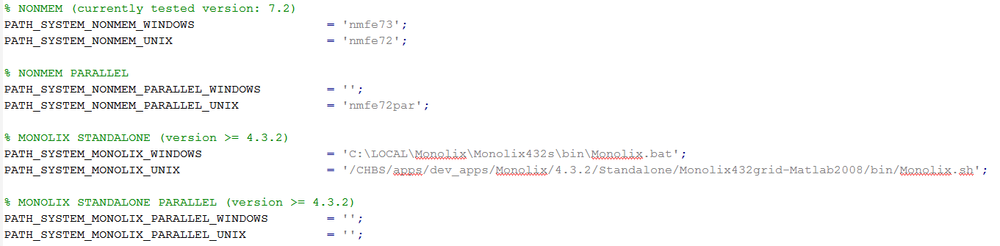
Installation of optional 3rd party software
Please follow the providers instructions when installing optional 3rd party software.
  Update the IQMpro/SETUP_PATHS_TOOLS_IQMPRO.m file with the relevant information, as shown below for an example implementation

Slide 13
IQM Tools’ Documentation
  MATLAB style help
IQM Tools Tutorials with examples
  Part 1: IQM Tools Lite (General Model Specification, Simulation, etc.)
  Part 2: IQM Tools Pro (MEX / Systems Biology/Pharmacology Projects)
  Part 3: IQM Tools Pro (Basic Pharmacometrics)
  Part 4: IQM Tools Pro (General Dataset Specification and PMX Workflows)
  Part 5: IQM Tools Pro (Advanced Clinical Trial Simulations)
  Part 6: IQM Tools Pro (Linking Systems Pharmacology Models to Clinical Data)
  IQM Tools – Workshops
    Given on demand and on some conferences during a year
>> help IQMlite
>> help IQMpro
>> help IQMsimulate
>> help IQMexportCSVdataset
>> doc IQMlite
>> doc IQMsimulate

Slide 14
Tutorial Outline
General introduction to the IQM Tools Suite
Compliance mode
Models: dosing, output and parameter definitions
Dosing description and simulation
Interface to NLME Tools
Nonlinear mixed effect modeling tools
Simulations

Slide 15
Compliance Mode
The Pharma World is highly regulated. For every modeler it is important to ensure that the complete modeling project (models, scripts, data, outputs) are well documented and all results are easily reproducible
IQM Tools allows to annotate each produced figure and each produced table or text file by the username of the modeler, date and time, and the names of the scripts that were run to produce the output
  This is accomplished by generating a .log file for each output (figure and text / table file)
  The IQM Tools Reporting package will link this log information with the table or figure in the generated report
  This feature is called „Compliance Mode“
  The Compliance Mode can be turned on or off in the IQMlite/SETUP_PATHS_TOOLS_IQMLITE.m setup file. When using IQM Tools for work on clinical projects, it should always be turned on.
IQM Tools additionally allows a very structured approach to coding / organization of models, scripts, output, data that allows reproducibility of results by any person

Slide 16

Setup the Compliance Mode
Change into the IQMlite folder
Switch on the Compliance Mode by setting the corresponding variable to 1
The log files are created when figures and text files are generated by the following IQM Tools commands:
  IQMprintFigure
  IQMwriteText2File

Slide 17

Example for Compliance Mode
Change into the „Example Files“ folder
„testscript.m“ is a template analysis script that as first step clears the workspace and installs IQM Tools and in a second step initializes the compliance mode
>> IQMnewscript('testscript') % Creates a template analysis script
>> edit testscript.m

Slide 18
Example for Compliance Mode
Add the following text into the testscript.m
Execute the whole script by pressing „F5“
=> Output files and associated .log files are created
%% Here your code starts
% Write example text to text file
text = 'Hello World!';
IQMwriteText2File(text,'textfile.txt')
% Write example figure to PNG file
t = [0:1:100];
plot(t,sin(0.1*t));
IQMprintFigure(gcf,'figurefile','png')
>> edit textfile.txt.log
>> edit figurefile.png.log

Slide 19

Example for Compliance Mode
Comment out the IQMinitializeCompliance call
Rerun the script by pressing „F5“
An error appears, since the compliance mode is set to on but no call to IQMintializeCompliance has been done after the last „clear all“
Edit the argument to the IQMinitializeCompliance call and rerun by „F5“
The name of the script and the input argument to IQMinitializeCompliance need to match

Slide 20
Additional Compliance / Reproducibility Considerations
Typical pharmacometric modeling and analysis code is „messy“ and very difficult to audit
IQM Tools allows a good organization of scripts, models, data, and outputs that is easy to understand
  In the workflow tools IQM Tools imposes such a structure
  In free modeling activities it is suggested that the modeler uses the following structure
    Root folder
      „Scripts“: Containing analysis scripts with numeric ordering, e.g.:
        SCRIPT_01_data_preparation
        SCRIPT_02_popPK
      „Data“: The datasets
      „Models“: The generated IQMmodels or NLME models
      „Output“: The generated output (figures, tables, etc.)
This structure will be used in the following examples (where applicable)

Slide 21
Tutorial Outline
General introduction to the IQM Tools Suite
Compliance mode
Models: dosing, output and parameter definitions
  Define dosing inputs
  Define observation outputs
  Define parameters to estimate and to use as regression parameters
Dosing description and simulation
Interface to NLME Tools
Nonlinear mixed effect modeling tools
Simulations

Slide 22
IQMmodel syntax linking the model to dosing inputs and observations in clinical data (for parameter estimation)
Same syntax as for IQMmodels
  ODEs or biochemical representation can be used
Additional elements
  INPUT*: Allows to define dosing inputs – linking to doses in datasets
  OUTPUT*: Allows to define outputs – linking to clinical observations in datasets
********** MODEL NAME
Linear two compartmental distribution PK model
********** MODEL STATES
d/dt(Ac) = -CL/Vc*Ac – Q/Vc*Ac + Q/Vp*Ap + INPUT1
d/dt(Ap) = + Q/Vc*Ac - Q/Vp*Ap
********** MODEL PARAMETERS
CL = 20 % (L/hour) Clearance
Vc = 32 % (L) Central volume
Q = 12 % (L/hour) Intercompartmental clearance
Vp = 1450 % (L) Peripheral volume
********** MODEL VARIABLES
Cc = Ac/Vc % Calculation of plasma concentration
OUTPUT1 = Cc
Example model

Slide 23
IQMmodel Syntax - INPUTs
INPUT Definitions in IQMmodels
  Please open the example file inputExamples.m in the folder
  Example Files/MODEL_SYNTAX and work it through
  Example for a single input definition in an ODE based model (model1.txt)
  Example for a single input definition in an model based on biochemical reaction equations (model2.txtbc)
  Both models above are mathematically identical.
  The inputExamples.m file contains also a more complex input example
********** MODEL STATES
d/dt(Ac) = -VMAX*Cc/(KM+Cc) + F*INPUT1
********** MODEL REACTIONS
=> Ac : v_input
vf = F*INPUT1
Ac => : v_clearance
vf = VMAX*Cc/(KM+Cc)

Slide 24
IQMmodel Syntax - INPUTs
A model can contain arbitrarily many input definitions
INPUT* where "*": 1,2,3,4,5. Indices do not need to be sequential and do not need to start at 1, but they need to be numeric
Input definitions are only allowed in differential equations and in reactions
In the latter case the reaction name in the ODE is replaced by the reaction expression to have the input definition in the ODE
A prefactor is allowed, e.g. 1.5*INPUT1 or (k1+k2)*INPUT2 or F*INPUT4 No postfactors are allowed. A "*" character has to stand between prefactor and INPUT* definition
Input terms (INPUT* identifier and prefactor) are only allowed to be added (+) to the differential equation. But they can be the first term in the ODE, not requiring a leading "+" sign
If a parameter with the name "INPUT*" is defined in the model, its value will not be changed during import. If the model does not contain an INPUT* parameter, it is added and set by default to "0". INPUT* is only allowed to be defined as a parameter. Not as a variable and not as a reaction
Only parameters (and numerical values) are allowed to be used in the definition of INPUT* prefactors. But no states, variables and reactions
INPUT* definitions are not allowed to be enclosed in any parentheses

Slide 25
IQMmodel Syntax - OUTPUTs
OUTPUT Definitions in IQMmodels
  Please open the example file inputExamples.m in the folder
  Example Files/MODEL_SYNTAX and work it through
  Example for a single output definition in an IQMmodel (model1.txt and model2.txtbc)
The reason for the availability of these OUTPUT* definitions is that IQMtools uses these when interfacing IQM Tools with pharmacometric parameter estimation tools (NONMEM and MONOLIX)
The right hand side of OUTPUT* definitions should NOT contain mathematical expressions, but only get assigned previously defined variables (in this example: Cc)
********** MODEL VARIABLES
Cc = Ac/Vc % (ng/ml) Plasma concentration
OUTPUT1 = Cc % (ng/ml) Output variable

Slide 26
IQMmodel Syntax - OUTPUTs
OUTPUT* where "*": 1,2,3,4,5, ... In contrast to INPUT* definitions, the OUTPUT indices NEED TO BE sequential, starting from 1. No number is allowed to be excluded
Output definitions are only allowed to appear in the model variables section
The right hand side of OUTPUT* definitions should NOT contain mathematical expressions, but only get assigned previously defined variables
OUTPUT* variables are NOT allowed to depend on INPUT* components

Slide 27
IQMmodel Syntax – Parameter Info
The last elements of the IQMmodel syntax are flags that indicate if a certain parameter should be estimated or obtained from a dataset (called: regression parameter)
This is done by adding in
the comment section of a
parameter the reserved
words <estimate> or
<regression>
If a parameter is neither
estimated nor provided as
regression parameter, its
value will be kept on the
value defined in the model
itself
Example Files/Model_Syntax/model_estimation.txt
********** MODEL PARAMETERS
% PK parameters obtained from dataset
F_subcut = 0.5 % <regression> (.)
CL = 0.303 % <regression> (L/day)
Vc = 2.83 % <regression> (L)
Q = 0.724 % <regression> (L/day)
Vp = 4.43 % <regression> (L)
VMX = 0.5 % <regression> (mg/day)
KM = 1.86 % <regression> (ug/ml)
% PD parameters to be estimated
BASELINE = 1 % (.)
kdeg = 0.1 % <estimate> (1/day)
EMAX = 1 % <estimate> (.)
EC50 = 1 % <estimate> (ug/ml)

Slide 28
Tutorial Outline
General introduction to the IQM Tools Suite
Compliance mode
Models: dosing, output and parameter definitions
Dosing description and simulation
  Definition of dosing schemes
  Simulation of dosing schemes
Interface to NLME Tools
Nonlinear mixed effect modeling tools
Simulations

Slide 29
IQMdosing Syntax
The IQM Tools allow to define dosing schedules in a simple but efficient format
The different dosing "inputs" then can be automatically applied to the inputs, defined in IQMmodels, using the INPUT* identifier
In this section we will explain how to define dosing schemes and how to merge them with models to simulate the desired dosing scheme on the desired model

Slide 30
IQMdosing Syntax
An example for a dosing scheme is the following
This dosing scheme defines that an INPUT1, defined in the model, should be implementing an infusion with a 14 day dosing interval, starting at time 0 with 5 repetitions, each dose 10 units and the infusion duration should be 2 hours
********** INPUT1
type: INFUSION
time: 0 % (days) time for first application
deltaT: 14 % (days) time inbetween applications
nr_repetitions: 5 % number of applications
D: 10 % (unit) dose
Tinf: 2/24 % (days) 2 hours

Slide 31
IQMdosing Syntax
Dosing schedules can be defined in several different ways, also different doses can be given at different times. The following dose-application-types can be defined:
  Bolus
  Infusion (both defining infusion rate or infusion time)
  0th-order Absorption (mathematically the same as Infusion. The difference is only when considering parameter estimation with NLME tools. If 0 order absorption is used, then the absorption time can be estimated, while for infusion either the time or the rate is taken from the dataset)
  1st-order Absorption
Optionally, each type can get a lag time assigned to it. Each dosing definition can define single doses or multiple doses

Slide 32
IQMdosing Syntax
Dosing definitions are contained in dosing files with the extension ".dos"
  ASCII text files which have a certain format and can contain an arbitrary number of input definitions
  Limitation: Each input definition needs to have a different name. For example "INPUT1" is not allowed to be defined more than once
Combining Models with Dosing Schedules
  The underlying idea is that a model, containing inputs (INPUT1, INPUT2, etc.) can be merged with a dosing description that defines these inputs to implement the corresponding dosing definitions. The result of this merge is again a model that now can be simulated
  Please open the example file dosingExamples.m in the folder
  Example Files/Dosing_Syntax and work it through

Slide 33
IQMdosing Syntax - Example
Assume you have the following model
And assume further that you want to
simulate a first order absorption in the
central compartment Ac
Then this is your dosing description
To merge model with dosing definition we need to
  1) Import the model
  2) Import the dosing definition
  3) Merge model with dosing definition to obtain a model for simulation
********** MODEL STATES
d/dt(Ac) = -VMAX*Cc/(KM+Cc) + F*INPUT1
********** MODEL PARAMETERS
VMAX = 1 % (ug/hour)
KM = 1 % (ng/ml)
Vc = 1 % (L)
F = 0.6 % (.)
********** MODEL VARIABLES
Cc = Ac/Vc % (ng/ml)
OUTPUT1 = Cc % (ng/ml)
********** INPUT1
type: ABSORPTION1
time: 0 % (hours)
D: 10 % (ug)
ka: 1 % (1/hour)

Slide 34
IQMdosing Syntax - Example
Change into the Example Files/Dosing_Syntax folder
Note the added elements and the naming of ka_input1, ...
>> model = IQMmodel('model1.txt'); % Import of model
>> dosing = IQMdosing('dosing2.dos'); % Import of dosing description
>> modeldosing = IQMmergemoddos(model,dosing); % Merge model and dosing description:
********** MODEL STATES
d/dt(Ac) = -VMAX*Cc/(KM+Cc)+vAbsorption_input1 %(ug/hour)
d/dt(Comp_input1) = input1-vAbsorption_input1
********** MODEL PARAMETERS
VMAX = 1 %(ug/hour) Maximum rate of elimination
KM = 1 %(ng/ml) At this concentration elimiation rate is half VMAX
Vc = 1 %(L) Central volume
F = 0.59999999999999998 %(.) Relative bioavailability
Dose_input1 = 10
Time_input1 = 0
DeltaT_input1 = 0.0001
ka_input1 = 1
********** MODEL VARIABLES
Cc = Ac/Vc %(ng/ml) Plasma concentration
OUTPUT1 = Cc %(ng/ml) Output variable
vAbsorption_input1 = ka_input1*Comp_input1
input1 = +F*Dose_input1/DeltaT_input1 *
piecewiseIQM(1,andIQM(ge(time,Time_input1),lt(time,Time_input1+DeltaT_input1)),0)

Slide 35
Tutorial Outline
General introduction to the IQM Tools Suite
Compliance mode
Models: dosing, output and parameter definitions
Dosing description and simulation
Interface to NLME Tools
  Conversion of IQMmodels to NONMEM and MONOLIX
  Running NONMEM and MONOLIX from IQM Tools
  Fitanalysis results – overview
  Robustness analysis
Nonlinear mixed effect modeling tools
Simulations

Slide 36
Conversion of IQMmodels to NONMEM and MONOLIX
IQM Tools allows to easily generate MONOLIX and NONMEM code for parameter estimation
In the following several examples will be provided, based on
  Theophylline data
The goal in this tutorial is not to perform a complete model building, but to show how a model of interest can be converted to the parameter estimation tool of choice and perform the parameter estimation
  We limit ourselves to a PK model
  In later tutorials PKPD models, regression parameters, etc. will be covered

Slide 37
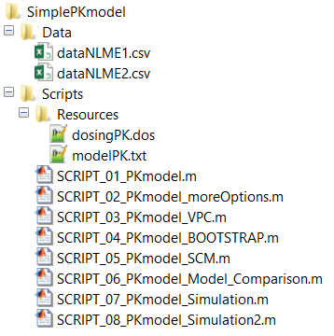
Theophylline Example
Change into Example Files/SimplePKmodel folder
Have a look at the
  two data files
  modelPK.txt file
  dosingPK.dos file
The two data files contain the same quantitative information, however the dataNLME1.csv file contains additional annotation that you might consider quite useful for the purpose of understanding of its contents
The modelPK.txt file contains the structural PK model that we want to convert to NONMEM and MONOLIX
The dosingPK.dos file contains information about the type of INPUT1 in the model

Slide 38
Required Dataset Columns (dataNLME2.csv)
Column Name | Meaning
IXGDF | Indices for records in the dataset. If dataset derived from a general dataset format each entry on IXGDF corresponds to the entry for IXGDF for this record in the general data format. If not derived, column still required.
ID | Unique numeric subject ID, used by NONMEM and MONOLIX
USUBJID | Unique subject ID, used in the clinical database
TIME | Time of event in a row with 0 determining time of first dose
TIMEPOS | Time of event in a row with 0 the time of the first event (needed for NONMEM, since crashing for negative times)
NT | Nominal time of the event (per protocol). Useful for binning
YTYPE | 0 for dose events, otherwise containing the number of the model OUTPUT with which this observation should be compared
DV | Observed value of this observation
CENS | If 1 then observation assumed to be below lower limit of quantification. DV then needs to contain the LLOQ. Otherwise CENS=0
MDV | =1 for doses, =0 for observations, =1 for „missing observations“ or observations that should not be considered for parameter estimation
EVID | =1 for doses, =0 for observations
AMT | =0 for observations, =value of dose for dosing events
ADM | =0 for observations, otherwise containing the number of the model INPUT to which this dose is to be applied
RATE | Rate of dose, 0 for bolus, AMT/infusion time for infusion, etc.

Slide 39
Useful Dataset Columns (dataNLME1.csv)
Column Name | Meaning
NAME | Name of the event in a row. Unique per YTYPE. Gives information about the actual readout. YTYPE=1 does not say much. NAME = „Theophylline Concentration“ is more informative. Will be used by IQM Tools, e.g., for annotation of simulations, VPCs, etc. The reason for „:::“ in the NAME column is that NONMEM is unable to deal with spaces in text. IQM Tools will replace „:::“ by spaces for display purposes
UNIT | Unit of the observation or dose in a row. Will be used by IQM Tools, e.g., for annotation of simulations, VPCs, etc.
TIMEUNIT | Unit of all time related information in the dataset (including RATE). Will be used by IQM Tools, e.g., for annotation of simulations, VPCs, etc.
TRTNAME | Treatment group name. In the Theopylline Example only a single treatment group is present, but still, it is informative. Will be used by IQM Tools, e.g., for annotation of stratified VPCs
TRT | Numeric equivalent to TRTNAME, can be used as a covariate.
ROUTE | Information about the route of administration
These additional columns make the dataset more complete and self explaining
In Part 5 of the tutorials we will learn about the general dataset format that is used by IQM Tools, which contains even more additional and very useful columns
It is sad but true that most data files in the pharmacometric world look like dataNLME2.csv

Slide 40
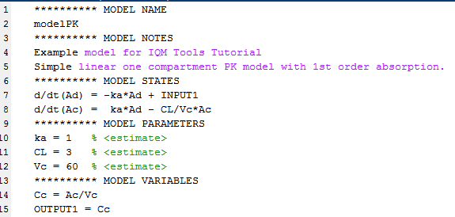
The Model
The modelPK.txt file is a standard IQMmodel, containing
  INPUT1 (to be linked to doses in data with ADM=1)
  OUTPUT1 (to be linked to observation records with YTYPE=1)
  3 parameters to be estimated (<estimate>)

Slide 41
Theophylline Example
Change into Example Files/SimplePKmodel/Scripts folder
Open SCRIPT_01_PKmodel.m in the MATLAB editor
  This script follows the „Compliance Guideline“ of IQM Tools
    Clean MATLAB workspace, path, etc
    Install IQM Tools
    Setup Compliance Mode
Please update line number 12 with the path of your IQM Tools installation:
Execute lines 4-16 in the script (highlight them and press „F9“)

Slide 42
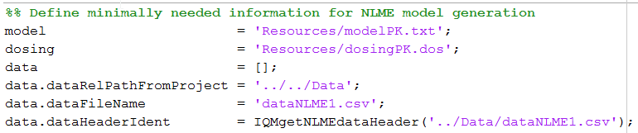
Theophylline Example
The following code in SCRIPT_01_PKmodel.txt defines the minimally needed information for model conversion to MONOLIX and NONMEM
Execute the code above
model | Relative path from the Scripts folder to the IQMmodel text file that should be used for conversion.
dosing | We need to define which INPUT type is desired. In the model only a single input INPUT1 is defined. Underlying assumption: INPUT1 is a bolus into the dosing compartment. Thus „dosing“ needs to have as first and only type „BOLUS“.
data | This is a MATLAB structure which contains 3 different fields related to the dataset location and its structure.
data.dataRelPathFromProject | Defined the relative path from the desired project folder location to the dataset. We plan to create the NLME project in ../Models/“projectname“.
data.dataFileName | Name of the dataset to be used (without path).
data.dataHeaderIdent | Cell-array with identifiers, defining the meaning of the columns in the dataset.

Slide 43
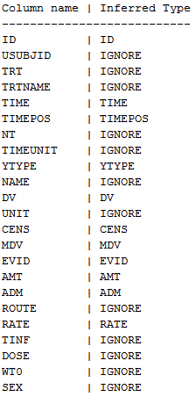
data.dataHeaderIdent
In this example:
data.dataHeaderIdent = {ID,IGNORE,IGNORE,IGNORE,TIME,TIMEPOS,IGNORE,IGNORE,YTYPE,IGNORE,DV,IGNORE,CENS,MDV,EVID, AMT,ADM,IGNORE,RATE,IGNORE,IGNORE,IGNORE,IGNORE}
MONOLIX users will understand what it means
If you are a NONMEM user, then please have a look in the
MONOLIX manual
The good thing is that the function IQMgetNLMEdataHeader
generates this header automatically and correctly
>> help IQMgetNLMEdataHeader

Slide 44
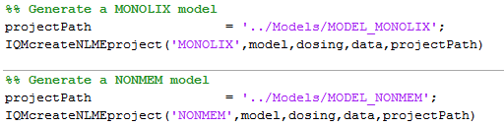
MONOLIX and NONMEM Model Creation
The function IQMcreateNLMEproject creates NONMEM or MONOLIX models
Additionally to the previously defined information the „projectPath“ needs to be defined. This is the path to the folder in which to create the NLME model
Execute the code above

Slide 45
MONOLIX and NONMEM Model Creation
Change into Example Files/SimplePKmodel/Models folder
Have a look at the generated NONMEM and MONOLIX code
Default settings for IQMcreateNLMEproject
  NONMEM: SAEM
  Lognormal distribution for individual parameters
  Additive error model
  Diagonal covariance matrix
  Etc.
IQMcreateNLMEproject has many optional argument, allowing to control most NLME features of interest
>> help IQMcreateNLMEproject

Slide 46
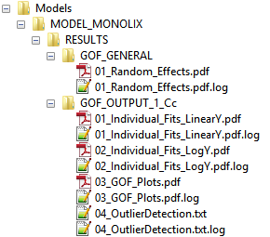
Running NONMEM and MONOLIX Models
Change into Example Files/SimplePKmodel/Scripts folder
An NLME model can be run by the following command
Change into Example Files/SimplePKmodel/Models folder
Have a look at the content in the RESULTS folders
for both models
  The subfolders in the RESULTS folders contain a wide range
  of goodness of fit assessments for the models – no need to
  postprocess the output of NONMEM and MONOLIX manually
>> help IQMrunNLMEproject % Get help
>> IQMrunNLMEproject('../Models/MODEL_MONOLIX') % Run the MONOLIX model
>> IQMrunNLMEproject('../Models/MODEL_NONMEM') % Run the NONMEM model

Slide 47
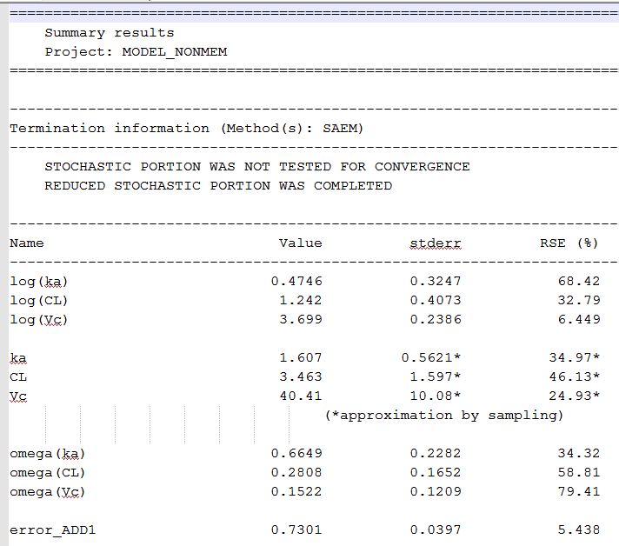
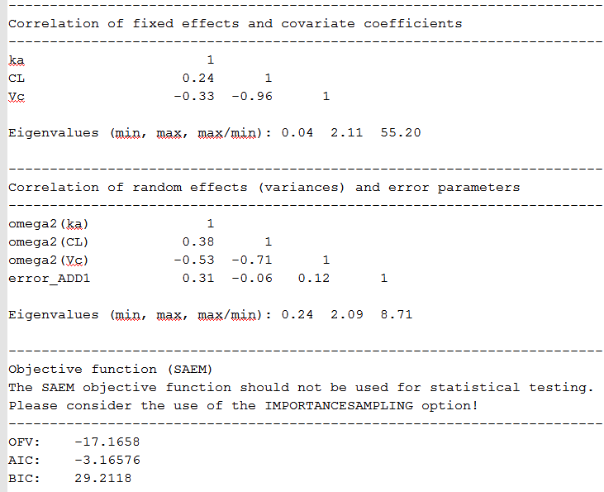
Results on NONMEM and MONOLIX runs
Have a look at the project_results.txt file in the MODEL_NONMEM/RESULTS folder
Compared to the typical NONMEM log file this one is very readable and informative

Slide 48
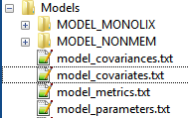
Running all NLME Models in a Folder
If NLME models/projects are located within the same top folder (here: „Models“), they can be run in parallel by the following command:
  Parallel runs only possible if the parallel toolbox for MATLAB available, otherwise these models will be run sequentially
  Parallel runs also require correct setup of IQMpro/SETUP_PATHS_TOOLS_IQMPRO.m
Using IQMrunNLMEprojectFolder will generate additional information in the folder in which the NLME projects are located – have a look at “../Models” – it now contains four additional files (and their 4 log files)
  model_metrics.txt, model_parameters.txt,
  model_covariates.txt, model_covariances.txt
  Have a look at these files – self explaining and we will see more
  in the tutorials
>> help IQMrunNLMEprojectFolder % Get help
>> IQMrunNLMEprojectFolder('../Models') % Run all NLME models in folder

Slide 49
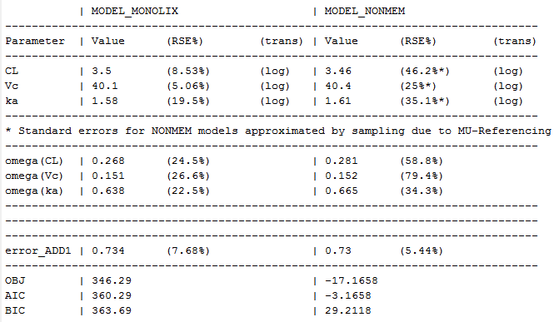
Creation of Model Result Tables
Execute the following code in the script
This produces the following table, which with the reporting package of IQM Tools can be directly included into Word, LaTeX and HTML reports
See the „../Output“ folder for the generated table text file and the associated log file

Slide 50
Defining more Options for NLME Model Generation
The function IQMcreateNLMEproject has many optional settings, which might require quite some text for their definition. It is still far easier than to write MONOLIX or NONMEM code, but it takes time
IQM Tools contains a function that generates template code with almost all features, allowing the user to do quick modifications and be done
Preparation for tutorial example
  Change into Example Files/SimplePKmodel/Scripts folder
  Open SCRIPT_02_PKmodel_moreOptions.m in the MATLAB editor
  Update line number 12 with the path of your IQM Tools installation
  Execute lines 4-16 in the script (highlight them and press „F9“)
>> help IQMcreateNLMEmodelGENcode

Slide 51
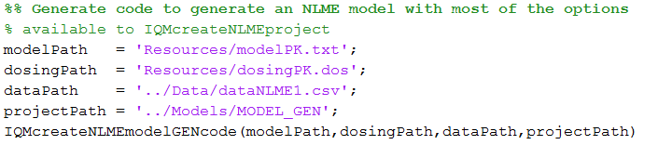
Defining more Options for NLME Model Generation
Execute the following code in the SCRIPT_02_PKmodel_moreOptions.m
  This command generates template text in a temporary file and opens it in the MATLAB editor
  Copy the generated code into the SCRIPT_02_PKmodel_moreOptions.m, starting from line 27
  Read through the generated code – it is very well documented in should be almost self explaining

Slide 52
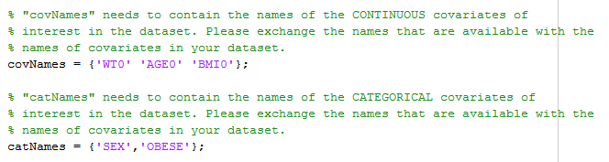
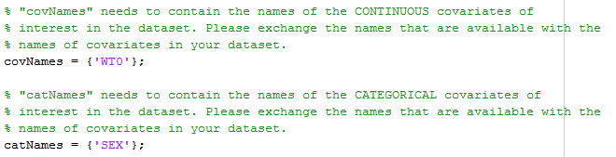
Defining more Options for NLME Model Generation
Locate the following lines in the generated code
Edit to match the following (we need to define the candidate covariates that are present in the dataset and which we might want to consider in the model)

Slide 53



Defining more Options for NLME Model Generation
Execute the first cell, defining the algorithm settings
Execute the second cell, defining the candidate covariates
In the third cell, please locate the following code
and update to match the following
This will estimate covariate coefficients for WT0 on CL and Vc, and SEX on CL.
In the third cell towards the bottom, please comment out either the NONMEM or the MONOLIX model generation
Execute the third cell, generating the NLME model and running it

Slide 54
Defining more Options for NLME Model Generation
Have a look at the output for the generated model in ../Models/MODEL_GEN
If you want, repeat the exercise with NONMEM instead of MONOLIX or vice versa
Interesting:
  The same NLME dataset is used for both tools
  Switching tools is not more complicated than switching „NONMEM“ for „MONOLIX“ or the other way round

Slide 55
A word about implementation of covariates
Previous example showed the use of WT0 and SEX as covariates, but not how these covariates are mathematically implemented in the NONMEM or MONOLIX model
IQM Tools handles covariates in the following way:
  MU-referencing when exporting to NONMEM (In MONOLIX this is implicitly done)
  Centers continuous covariates automatically by the median of the covariate in the dataset
  Log-transforms the centered continuous
  Numerically smallest category of a categorical covariate is used as references value
  Additive aggregation of covariate terms and MU in the transformed parameter domain (according to the chosen distribution of the individual parameters)
  Example continuous covariate (with assumed median of 70):
  Example categorical covariate (SEX=1 male, =2 female)
log(CL) = log(TCL) + beta*log(WT0/70)
=> CL = TCL*(WT0/70)^beta
log(CL_male) = log(TCL)
log(CL_female) = log(TCL) + beta

Slide 56
A word about implementation of covariates
This means that the implementation of the covariates is slightly different from what Pharmacometricians are used to
However, the following needs to be considered:
  For the typical applications in the Pharma industry such an approach is enough to identify covariates of clinical relevance and thus viable and acceptable
  For research applications where the goal is to assess many different possible covariate models and compare them to each other, IQM Tools still allows to code the mathematical expressions of the covariate models into the IQMmodels code.
    In this case, the following needs to be considered:
      Covariates need to be passed to the model as regression parameters
      The SAEM algorithm should not be used. Please used gradient based methods from NONMEM in this case
Any covariate expression is possible in IQM Tools, if defining models manually
For automatic tools, such as SCM, the standard approach is used
CL = TCL*(AGE0-40)^beta1*(1+beta2*(SEX-1))

Slide 57
Robustness Analysis of NLME Parameter Estimations
In order to assess the robutsness of parameter estimates it is possible to consider the standard errors of the estimated parameters
However, this often does not give the full picture and often is overly optimistic
IQM Tools allows to easily run the same model N times from randomized initial guesses
This allows to assess the robustness of the parameter estimates and thus the robustness of the model in detail
  Not robust models often are identified by a large difference in final objective function values and in correlations of parameter values with each other
In the following we will perform such a robustness analysis

Slide 58



Robustness Analysis of NLME Parameter Estimations
Locate the following lines in the code
Exchange against (since WT0 and SEX were not significant on CL)
Locate the following lines in the code
Setup the robustness analysis by exchanging with
Execute the 3rd cell to generate the 10 models

Slide 59
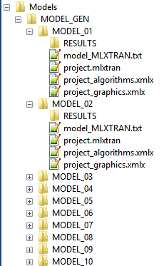


Robustness Analysis of NLME Parameter Estimations
Have a look into Models/MODEL_GEN
  10 Models have been generated
  Only difference: randomly sampled initial guesses for the
  fixed effect parameters that are estimated
Execution of the third cell lead to an error when
attempting to run the models with the command
Here there are several models generated in
„projectPath“ and thus the above command needs to be
exchanged to
Re-run the third cell to generate and run the 10 models

Slide 60
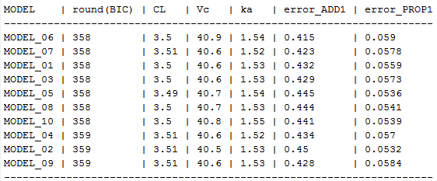
Robustness Analysis of NLME Parameter Estimations
Please have a look at the folder Models/MODEL_GEN and the contained text files
These give a good overview of the robustness of this model
Note: the purpose of this robustness functionality is not to try to find some initial guesses that might make a numerically unstable NLME Tool of choice to converge to a solution, as PsN Execute does. The goal of this function is to generate valuable information about a models robustness to allow the modeler to take decisions with respect to which parameters (fixed and/or random) to estimate and which not.

Slide 61
Tutorial Outline
General introduction to the IQM Tools Suite
Compliance mode
Models: dosing, output and parameter definitions
Dosing description and simulation
Interface to NLME Tools
Nonlinear mixed effect modeling tools
  VPC
  Bootstrap
  Stepwise covariate search
  Model comparison
Simulations

Slide 62
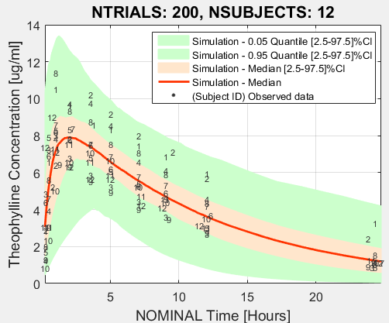
Generation of a VPC
IQM Tools contains several functions for the generation of VPCs
Please have a look at the following ones
Ensure your MATLAB working folder is „Scripts“
Run the following code:
You also find this code in
SCRIPT_03_Pkmodel_VPC.m
>> help IQMcreateVPC
>> help IQMcreateVPCstratified
>> help IQMcreateVPCplot
>> NLMEproject = '../Models/MODEL_GEN/MODEL_06';
>> model = 'Resources/modelPK.txt';
>> data = '../Data/dataNLME1.csv';
>> IQMcreateVPC(NLMEproject,model,data)

Slide 63
Running a Bootstrap
IQM Tools allows to easily run bootstraps on NLME models, resampling the dataset for each run, allowing for specification of a stratification group
Ensure your MATLAB working folder is „Scripts“
Run the following code:
You also find this code in
SCRIPT_04_Pkmodel_BOOTSTRAP.m
>> help IQMbootstrap
projectPath = '../Models/MODEL_GEN/MODEL_06';
options = [];
options.path = '../Models/Bootstrap_Example
options.NSAMPLES = 24;
options.GROUP = 'SEX';
IQMbootstrap(projectPath,options)

Slide 64
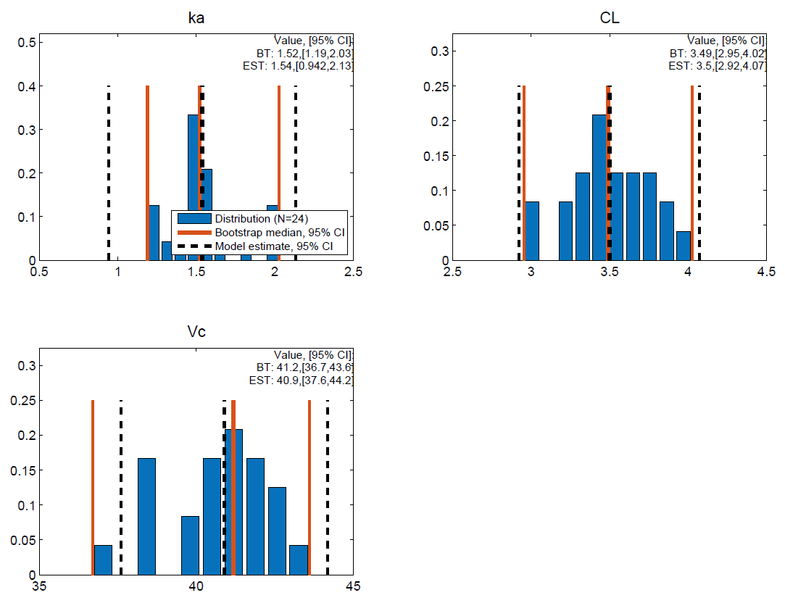
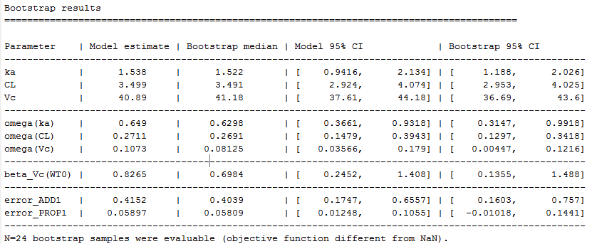
Bootstrap Results
Please have a look in the Models/Bootstrap_Example folder
Results are generated as tables and as graphics

Slide 65
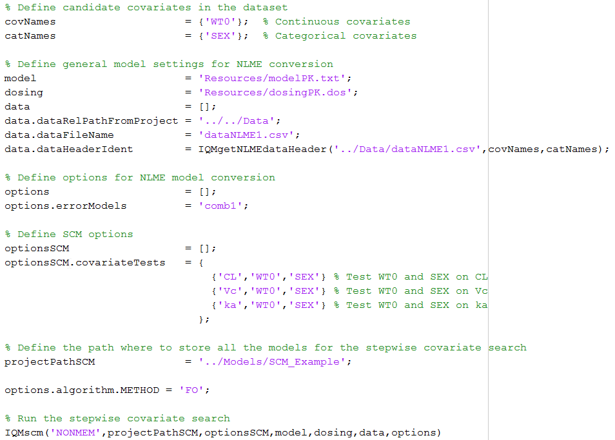
Stepwise Covariate Search (SCM)
IQM Tools has inbuilt functionality to perform the typical stepwise covariate search
SCRIPT_05_PKmodel_SCM.m
contains the code to the
right, which performs the
stepwise covariate search
Input arguments contain same
arguments as call to
IQMcreateNLMEproject
Open the script and execute it
>> help IQMscm

Slide 66
Stepwise Covariate Search Results
Please have a look in the Models/SCM_Example folder
An SCM logfile (SCMlogfile.txt) is provided with the results of the SCM
Each subfolder contains more information about the different explored models
A word of caution:
  Do not use NONMEM SAEM for stepwise covariate search – it won‘t make you happy
  MONOLIX SAEM works fine, due to its considerably better numerical stability
  Gradient based methods (NONMEM FO, FOCE, FOCEI) are fine as well. Often FO sufficient to explore the important covariates.
When doing the SCM (and/or bootstrap) the availability of the MATLAB parallel toolbox will speed up the analysis considerably

Slide 67
Model comparison
From time to time it is useful to compare the simulations of two or more models with each other for a dosing and observation scheme of interest
  A 3 compartment model might seem superior to a 2 compartment one based on OFV
  But is this real and of clinical importance?
The model comparison allows to simulate selected models for a dosing and observation scheme of interest and will provide a figure with the simulation results (median and 90% variability bands)
In this example we will compare the NONMEM with the MONOLIX model, generated in the first step
Please open the SCRIPT_06_PKmodel_Model_Comparison.m it contains the code to perform the model comparison
>> help IQMcompareModels

Slide 68
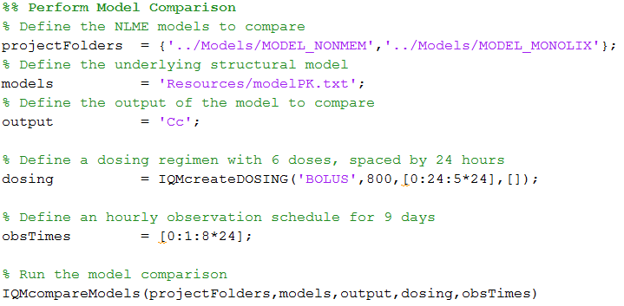
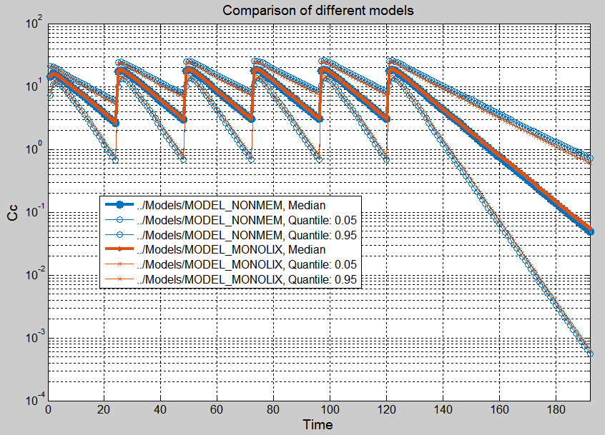
Model comparison Results
The following code generates the model comparison results
IQMcompareModels has many optional
settings that allow to customization
>> help IQMcompareModels

Slide 69
Tutorial Outline
General introduction to the IQM Tools Suite
Compliance mode
Models: dosing, output and parameter definitions
Dosing description and simulation
Interface to NLME Tools
Nonlinear mixed effect modeling tools
Simulations

Slide 70
Simulations of NLME Models
With IQM Tools simulations are straight forward. From very simple ones (dosing schedules, as shown previously) to very complex clinical trial simulations
The underlying principle for simulations of NLME models in IQM Tools is the following
NLME Project
Sample N sets
of parameters
Sampling can consider uncertainty, covariates, etc. Population or individual parameters can be sampled, depending on what the goal of the simulation is
NLMEproject contains the results of the parameter estimations (paramenter point estimates, correlation matrices, standard errors, variability distributions, transformations, covariates, etc.)
IQMmodel +
IQMdosing
Simulate IQMmodel
for sampled parameters
Postprocess and
display results
IQMmodel contains the mathematical model structure and the parameters that have been estimated in the NLME project
Simulation with the inbuilt simulator in IQM Tools allows fast integration and user friendly use. No simulation dataset needs to be generated. Even complex adaptive clinical trial simulations are just a couple of lines of code away

Slide 71
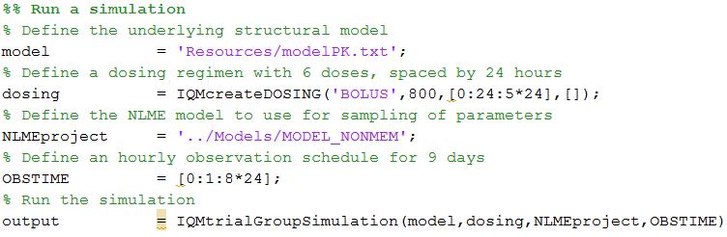
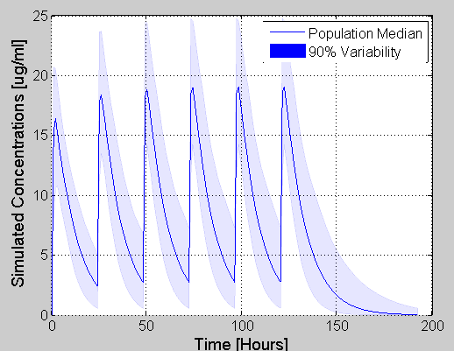
Simulations of NLME Models
Open the SCRIPT_07_Pkmodel_Simulation.m
Execute the following code
  This performs a simulation
  using the IQMtrialGroupSimulation
  function
  The user needs to plot the results
  In the script the plotting is performed
  with the result below to the right:
IQMtrialGroupSimulation is a higher level function
with many options:
>> help IQMtrialGroupSimulation

Slide 72
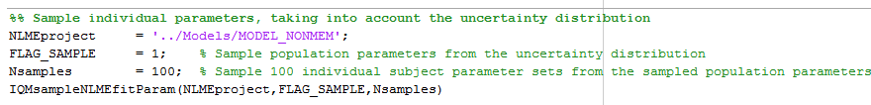
Simulations of NLME Models
More control over the simulation is obtained by performing some more manual steps
Step 1: Sampling parmeters from an NLME project
  See the example code in SCRIPT_07_Pkmodel_Simulation.m
  The IQMsampleNLMEfitParam function can take into account continuous and categorical covariates when sampling parameters. Please read the help text of this function - it is straight forward!
>> help IQMsampleNLMEfitParam
>> help IQMsampleNLMEfitParam

Slide 73
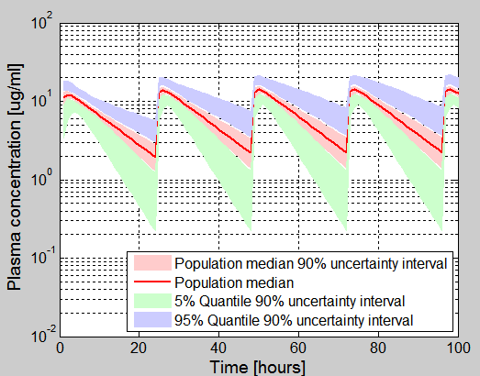
Simulations of NLME Models
Open the SCRIPT_08_Pkmodel_Simulation2.m
Work through this script, it shows an example for clinical trial simulation

Slide 74
Tutorial Goal: „You should now be able to“
Define models using ODEs and/or biochemical reactions
Simulate and analyze models
Simulate models for defined dosing inputs
Define and simulate experiments on models
Define measurement data, import, export, plotting

Slide 75
THE END
Thank you for your participation and interest!
The tutorial continues in Part 4 (IQM Tools Pro / General Dataset Specification and PMX Workflows)

